Slide 1



IT 493 Assignment 5
Product Roadmap
Tour Catchers LLC
Team #4
Tour Catchers LLC​ – Team 4
1

Slide 2
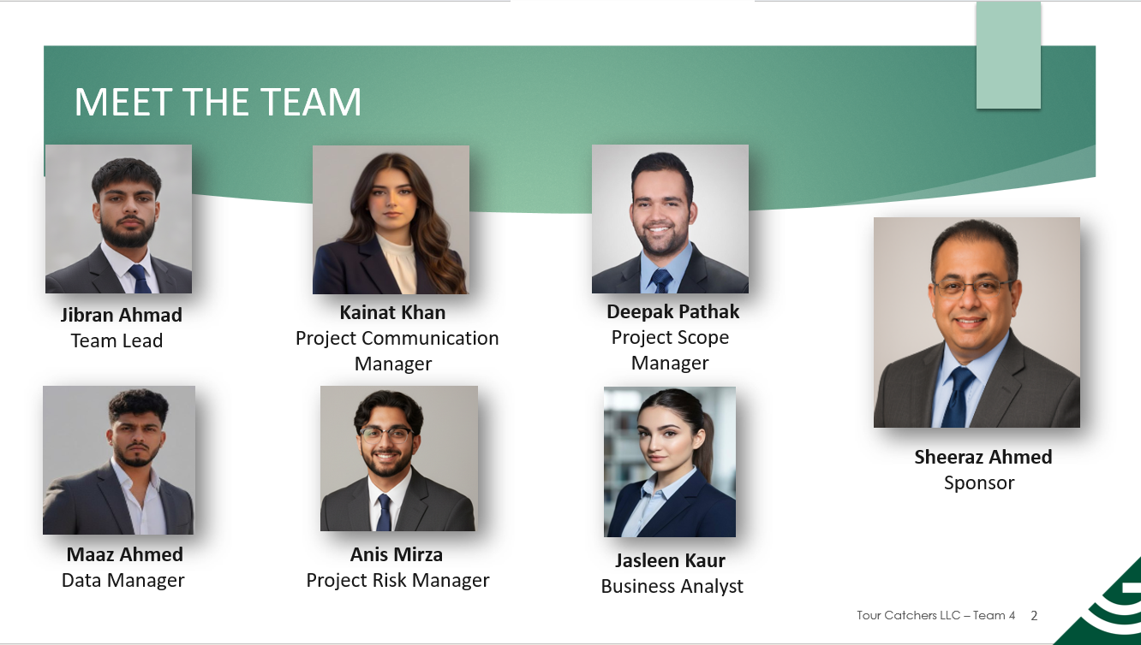
Tours Catchers LLC​ – Team 4
2

Slide 3
AGENDA
Product Development Roadmap
Agile Approach
Milestones
Releases
Communication
Features
Integration & Testing
Citations
Tour Catchers LLC​ – Team 4
3

Slide 4
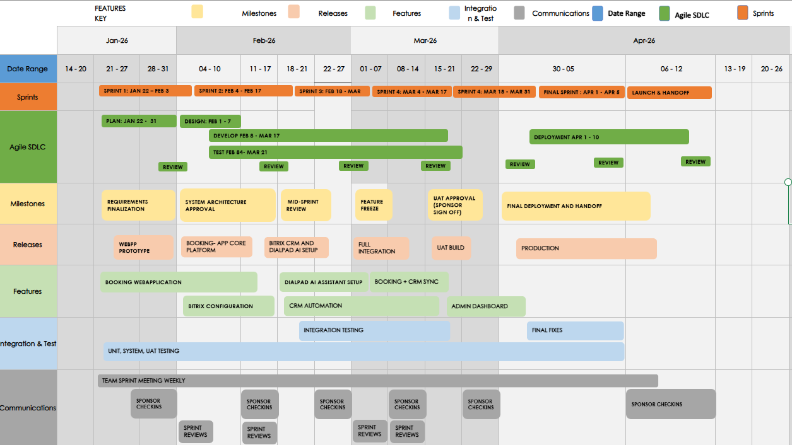
PRODUCT DEVELOPMENT ROADMAP
MILESTONES
RELEASES
FEATURES
INTEGRATION & TESTING
COMMUNICATION
CITATIONS
AGILE APPROACH
Product Development Roadmap Assignment 5_IT493 - Product Roadmap-Template.xlsx
4
Notes:
4

Slide 5
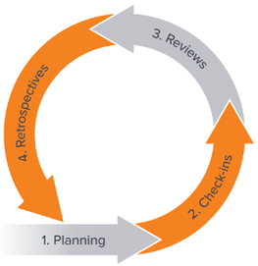
PRODUCT DEVELOPMENT ROADMAP
MILESTONES
RELEASES
FEATURES
INTEGRATION & TESTING
COMMUNICATION
CITATIONS
AGILE APPROACH
Agile Approach
Sprint | Dates | Focus
Sprint 1 | Jan 22 – Feb 3 | Requirements + prototype kickoff
Sprint 2 | Feb 4 – Feb 17 | Core Booking Web App + CRM base
Sprint 3 | Feb 18 – Mar 3 | Bitrix CRM + Dialpad AI setup
Sprint 4 | Mar 4 – Mar 17 | Full integration + system testing
Sprint 5 | Mar 18 – Mar 31 | UAT build + sponsor validation
Final Sprint | Apr 1 – Apr 5 | Final fixes + production readiness
Launch/Handoff | Apr 6 – Apr 10 | Deployment + documentation + training
These sprints show the work plan exactly by start and end date, which matches the
Agile requirement. Each sprint concludes with a formal review and sponsor validation to ensure
progress aligns with project goals before moving forward.
5
Notes:
5

Slide 6
PRODUCT DEVELOPMENT ROADMAP
AGILE APPROACH
MILESTONES
RELEASES
FEATURES
INTEGRATION & TESTING
COMMUNICATION
CITATIONS
SDLC Phases (Plan → Review)
SDLC Phase | When It Happens (Every Sprint) | What Happens
Plan | Start of each sprint | Define sprint goals, user stories, scope, and acceptance criteria
Design | Early in the sprint | Design architecture, workflows, and UI needed for sprint features
Develop | Throughout the sprint | Build features, configure systems, integrate components
Test | Continuous during sprint | Unit, integration, and system testing alongside development
Deploy | End of sprint (incremental) | Deploy completed features to staging or production
Review | End of sprint | Sprint review, demo to sponsor, collect feedback
In an Agile approach, each sprint follows a complete SDLC cycle from planning through review. Planning, design, development, testing, deployment, and review occur within every sprint to deliver incremental value. This enables continuous feedback, early issue detection, and regular sponsor validation.
6
Notes:
6

Slide 7
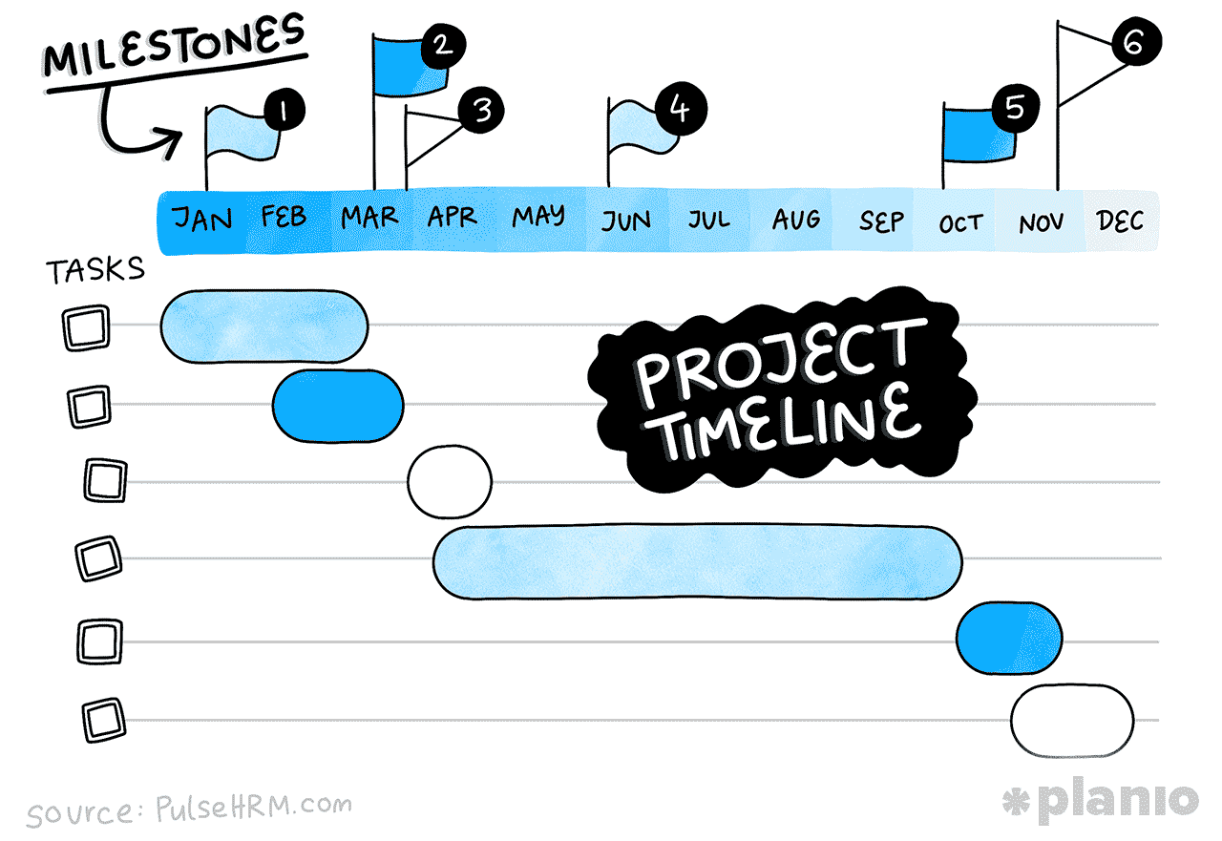
PRODUCT DEVELOPMENT ROADMAP
AGILE APPROACH
MILESTONES
RELEASES
FEATURES
INTEGRATION & TESTING
COMMUNICATION
CITATIONS
Jan 22 – Jan 31
Requirements Finalization
Sponsor confirms scope + priorities
Feb 1 – Feb 7
System Architecture Approval
Sponsor approves design & workflows
Feb 18 – Feb 21
Mid-Sprint Review
Validate integrations & progress
Key Product Milestones
Apr 6 – Apr 10
Deployment & Handoff
Final Release + training + closure
Mar 18 – Mar 21
UAT Approval (Sponsor sign off)
Sponsor validates system
Mar 4 – Mar 7
Feature Freeze
Lock features for final testing
These milestones mark key approval and review points throughout the project timeline, from requirements finalization to final deployment and handoff. Each milestone confirms that deliverables meet expectations before progressing to the next stage of development.
7
Notes:
7

Slide 8
PRODUCT DEVELOPMENT ROADMAP
AGILE APPROACH
MILESTONES
RELEASES
FEATURES
INTEGRATION & TESTING
COMMUNICATION
CITATIONS
System Release Timeline
Release | Date | Delivered capability
R1 | Feb 3 | Booking Web App Prototype
R2 | Feb 17 | Booking Web App Core + Bitrix CRM base
R3 | Mar 3 | Bitrix CRM + Dialpad AI Setup
R4 | Mar 17 | Full System Integration (Web App + CRM + AI)
R5 | Mar 21 | (UAT) User Acceptance Testing Build
R6 | Apr 10 | Production Release + Handoff
Releases represent the planned points where completed features are packaged and made available for validation or use. Each release builds on the previous one, gradually expanding system functionality across the Booking Web App, Bitrix CRM, and Dialpad AI. This approach allows the sponsor to review progress incrementally before the final production release.
8
Notes:
8

Slide 9
PRODUCT DEVELOPMENT ROADMAP
AGILE APPROACH
MILESTONES
RELEASES
FEATURES
INTEGRATION & TESTING
COMMUNICATION
CITATIONS
Key Product Features and Delivered Business Value
Booking Web Application
Provides a centralized platform for customers to browse tours and submit booking requests. Reduces manual coordination while improving accessibility and overall user experience.
Bitrix CRM Configuration
Centralizes customer, booking, and communication data in a single system. Improves organization, tracking, and visibility of customer interactions.
Dialpad AI Assistant Setup
Enables AI-powered call handling and automated responses to common customer inquiries. Reduces response time and improves customer support efficiency.
CRM Automation
Booking + CRM Sync
Admin Dashboard
Automates follow-ups, notifications, and workflow tasks within the CRM. Minimizes manual effort and ensures consistent customer communication.
Synchronizes booking data between the web application and Bitrix CRM. Eliminates duplicate data entry and improves data accuracy across systems.
Provides administrators with a consolidated view of bookings, customers, and system activity. Supports informed decision-making and easier system management.
9
Notes:
9

Slide 10
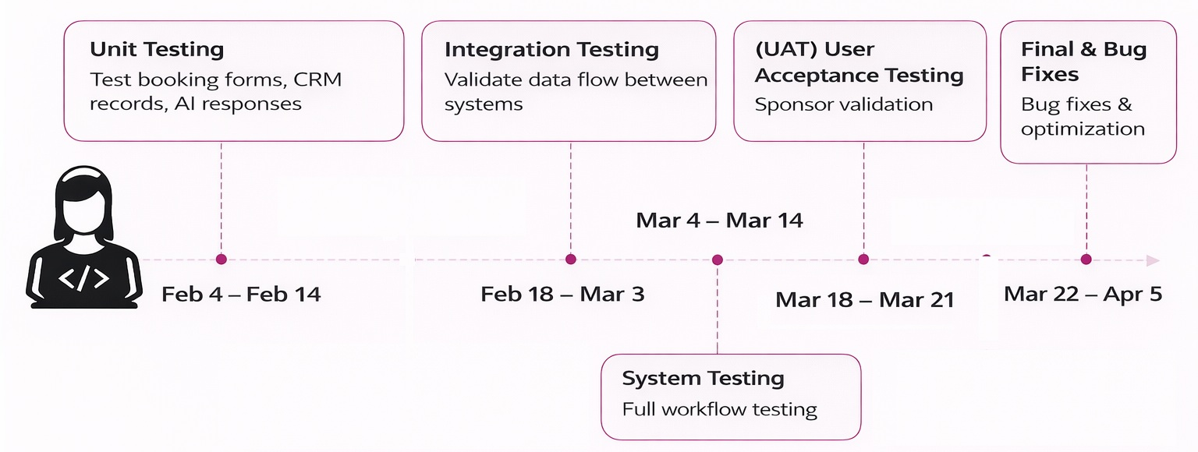
PRODUCT DEVELOPMENT ROADMAP
AGILE APPROACH
MILESTONES
RELEASES
FEATURES
INTEGRATION & TESTING
COMMUNICATION
CITATIONS
Integration & Testing
This testing life cycle is conducted throughout the Software development life cycle. However, Unit, System and UAT testing will be conducted in every sprint for the best outcome as shown in the product roadmap excel sheet.
10
Notes:
10

Slide 11



PRODUCT DEVELOPMENT ROADMAP
AGILE APPROACH
MILESTONES
RELEASES
FEATURES
INTEGRATION & TESTING
COMMUNICATION
CITATIONS
Team & Sponsor Communication
Communication | Frequency | Purpose
Team Sprint Meeting | Weekly | Track progress + blockers
Sponsor Check-ins | Once every two weeks | Approvals + alignment
Sprint Reviews | End of sprint | Demo work + gather feedback
Final Presentation/Handoff | Once | Deliver product + training
This communication plan ensures consistent coordination among team members and regular alignment with the project sponsor throughout the development timeline. Ongoing check-ins and reviews support transparency, timely feedback, and informed decision-making.
11
Notes:
11

Slide 12

A SINCERE THANK YOU!
TO PROFESSOR HINE AND OUR GTA KIRAN FOR YOUR SUPPORT AND FEEDBACK!
Questions?
Tours Catchers LLC​ – Team 4
12

Slide 13
Citation References
Team 2026 IT-493 Assignment 1. George Mason University.
Jibran. A (2025). IT-493 Assignment 2. George Mason University.
Team 2026. (2025). IT-493 Assignment 3. George Mason University.
Khan, K. (2025). IT-492 Assignment 2. George Mason University.
Khan, K. (2025). IT-492 Assignment 3. George Mason University.
Khan, K. (2025). IT-492 Assignment 4. George Mason University.
Khan, K. (2025). IT-492 Assignment 5. George Mason University.
Kaur, J. (2025). IT-492 Assignment 6. George Mason University.
Pathak, D. (2025). IT-492 Assignment 7. George Mason University.
Kaur, J. (2025). IT-492 Assignment 8. George Mason University.
Mughal, M. A. (2025). IT-492 Assignment 9. George Mason University.
Mirza, A. (2025). IT-492 Assignment 10. George Mason University.
Ahmad, S. (2025). TourCatchers LLC: Sponsor interview and process input [Personal communication, September 25, 2025].
GeeksforGeeks. (n.d.). Waterfall model. https://www.geeksforgeeks.org/waterfall-model/
GeeksforGeeks. (n.d.). What is agile methodology? https://www.geeksforgeeks.org/what-is-agile-methodology/
TourCatchers LLC project team. (2025). Project team meetings (October 20, November 1, and November 10, 2025).
Waterfall Research| https://www.geeksforgeeks.org/waterfall-model/
Agile Research| https://www.geeksforgeeks.org/what-is-agile-methodology/
Team Meatings
Tours Catchers LLC​ – Team 4
Slide 13

